Slide 1
From Beginning to End: An Overview of Systems Analysis and Design
Chapter 1
Systems Analysis and Design in a Changing World 7th Ed
Satzinger, Jackson & Burd

Slide 2
Day 1 Activities
Core Process 2: Plan the Project
Determine the major components (functional areas) that are needed
Supplier information subsystem
Product information subsystem
Define the iterations and assign each function to an iteration
Decide to do Supplier subsystem first
Plan one iteration as it is small and straight forward
Determine team members and responsibilities

Slide 3
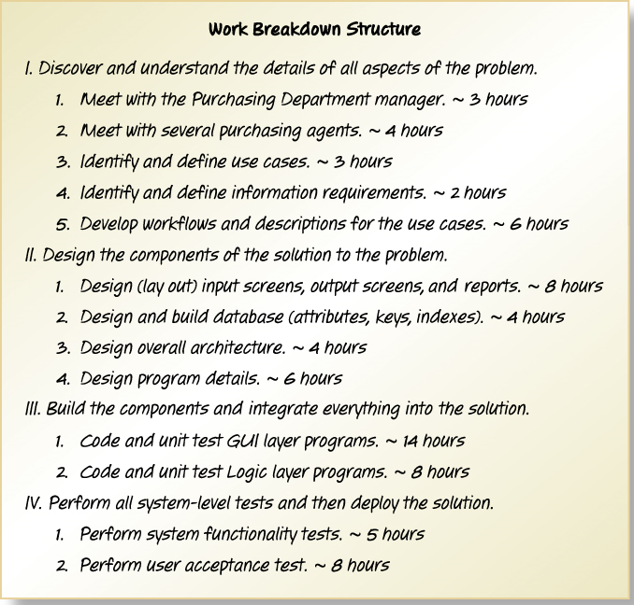
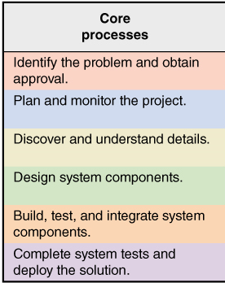
Work Breakdown Structure for Iteration
Describes the work and covers Core Processes 3, 4, 5, and 6

Slide 4
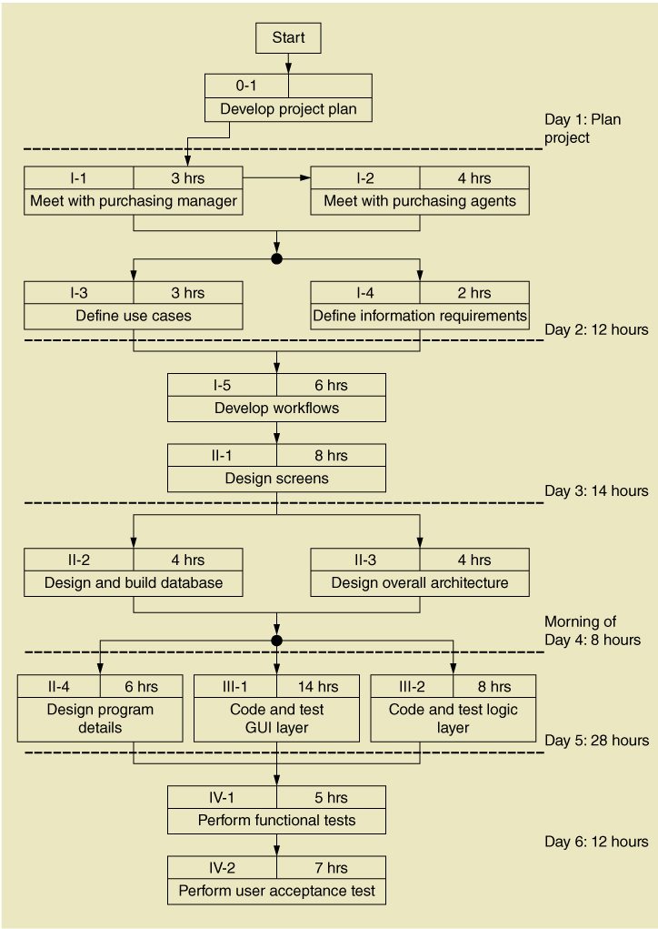
Work Sequence Draft for Iteration
Elaborates the Work Breakdown Structure

Slide 5
Day 2 Activities
Core Process 3: Discover and Understand Details
Do preliminary fact-finding to understand requirements
Develop a preliminary list of use cases and a use case diagram
Develop a preliminary list of classes and a class diagram

Slide 6
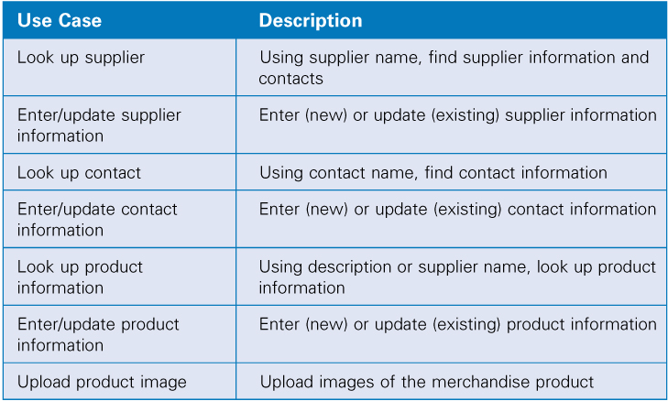
Identify Use Cases Both subsystems

Slide 7
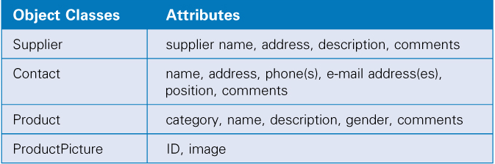
Identify Object Classes Both subsystems

Slide 8
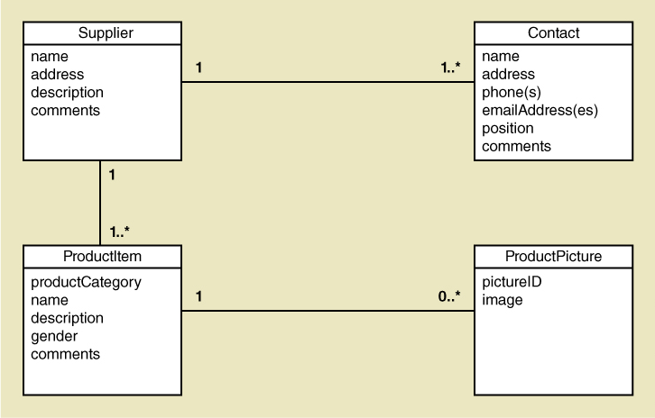
Preliminary Class Diagram Both subsystems

Slide 9
Day 3 Activities
Core Process 3: Discover and Understand Details
Do in-depth fact-finding to understand requirements
Understand and document the detailed workflow of each use case
Core Process 4: Design System Components
Define the user experience with screens and report sketches

Slide 10
Supplier Information Subsystem
Use cases:
Look up supplier
Enter/update supplier information
Lookup contact information
Enter/update contract information

Slide 11
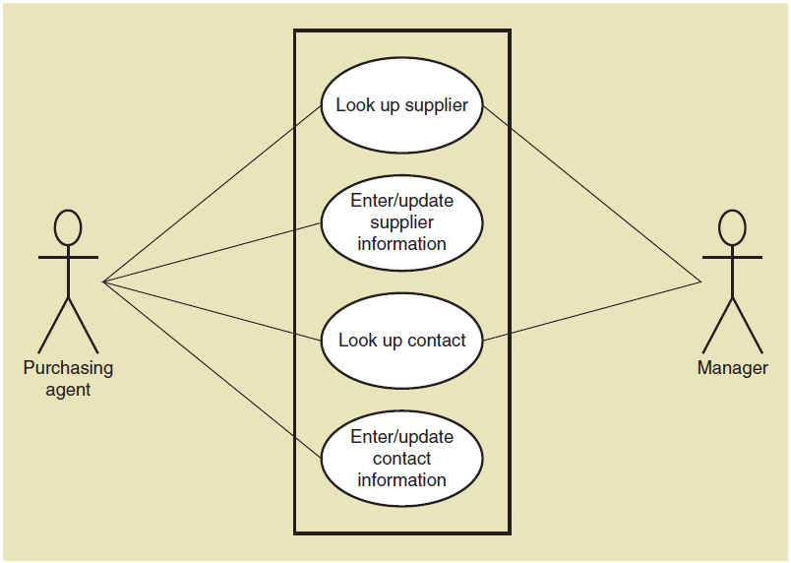
Use Case Diagram Supplier information subsystem

Slide 12
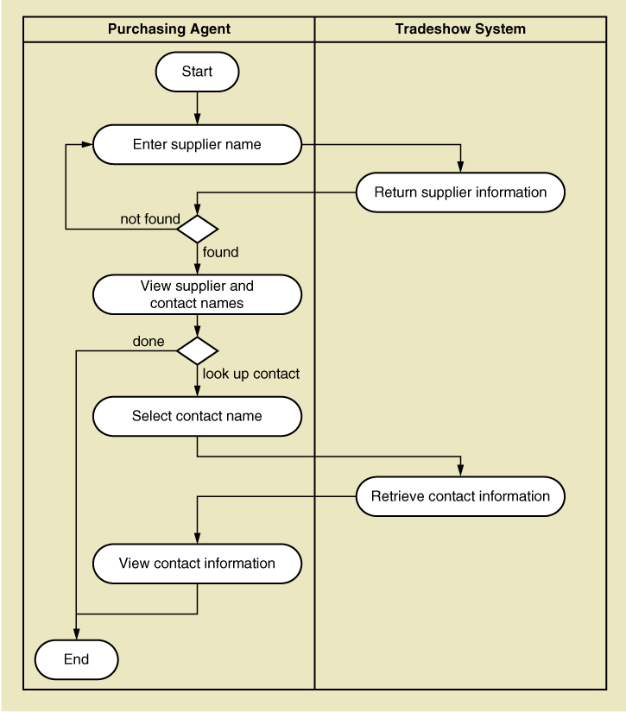
Activity Diagram (Workflow)
Look up supplier use case

Slide 13
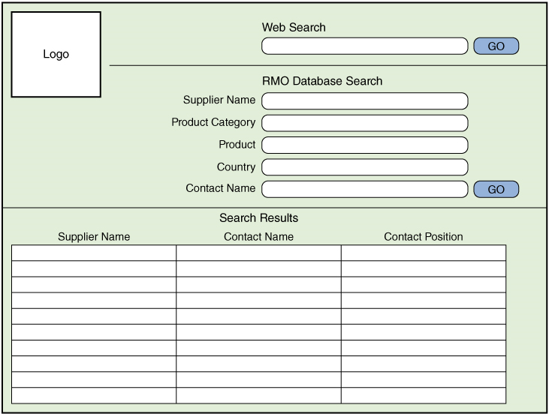
Draft Screen Layout Look up supplier use case

Slide 14
Day 4 Activities
Core Process 4: Design System Components
Design the database (schema)
Design the system’s high level structure
Browser, Windows, or Smart phone
Architectural configuration (components)
Design class diagram
Subsystem architectural design

Slide 15
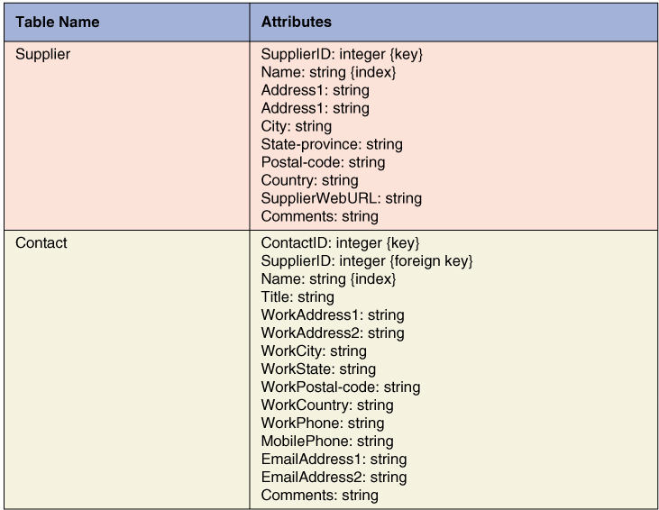
Database Schema

Slide 16
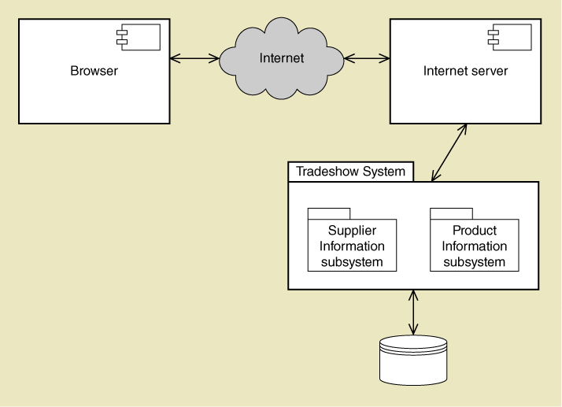
Architectural Configuration Diagram

Slide 17
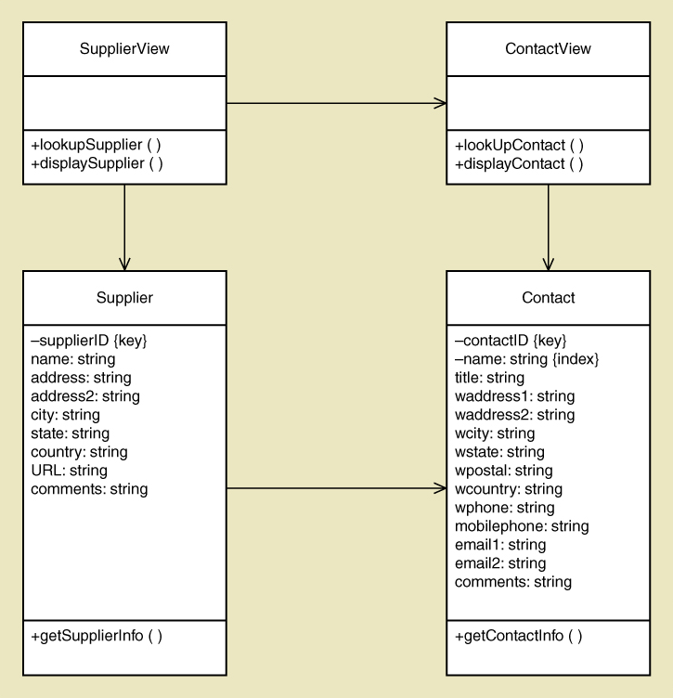
Preliminary Design Class Diagram
Includes View Layer Classes and Domain Layer Classes

Slide 18
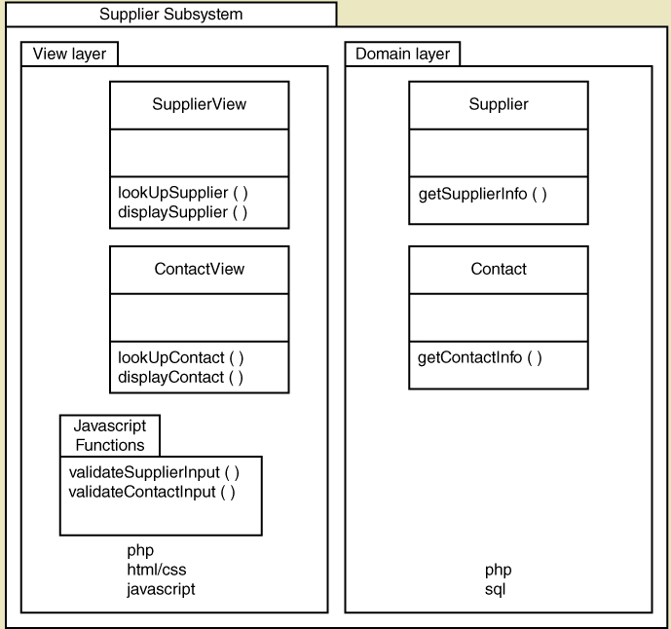
Subsystem Architectural Design Diagram

Slide 19
Notes on Managing the Project
Lots of design diagrams shown
Design in a complex activity with multiple levels
One diagram builds on/complements another
Not everything is diagrammed, especially for a small project. Pick and choose.
Programming is also done concurrently
You don’t design everything then code
You do some design, some coding, some design, some coding

Slide 20
Day 5 Activities
Core Process 4: Design System Components
Continue with design details
Proceed use case by use case
Core Process 5: Build, Test, and Integrate System Components
Continue programming (build)
Build use case by use case
Perform unit and integration tests

Slide 21
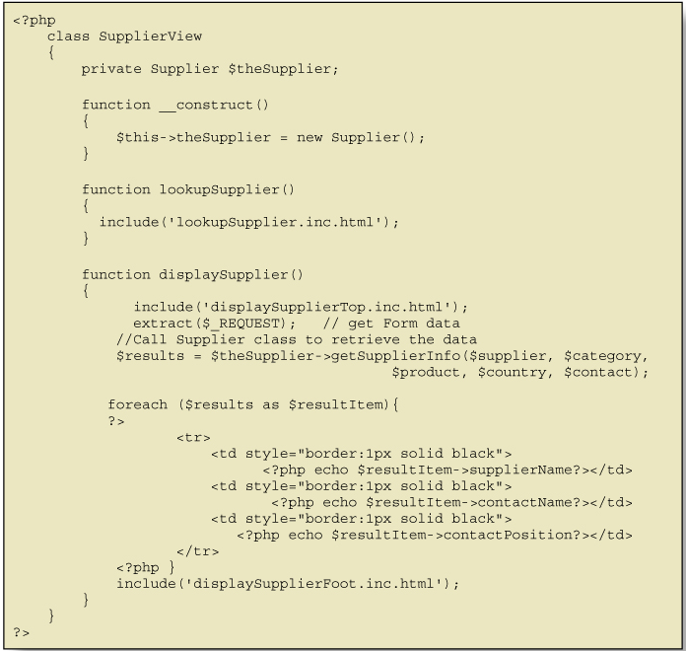
Code Example for One Class

Slide 22
Day 6 Activities
Core Process 6: Complete System Testing and Deploy the System
Perform system functional testing
Perform user acceptance testing
Possibly deploy part of system

Slide 23
Workflow of Testing Tasks

Slide 24
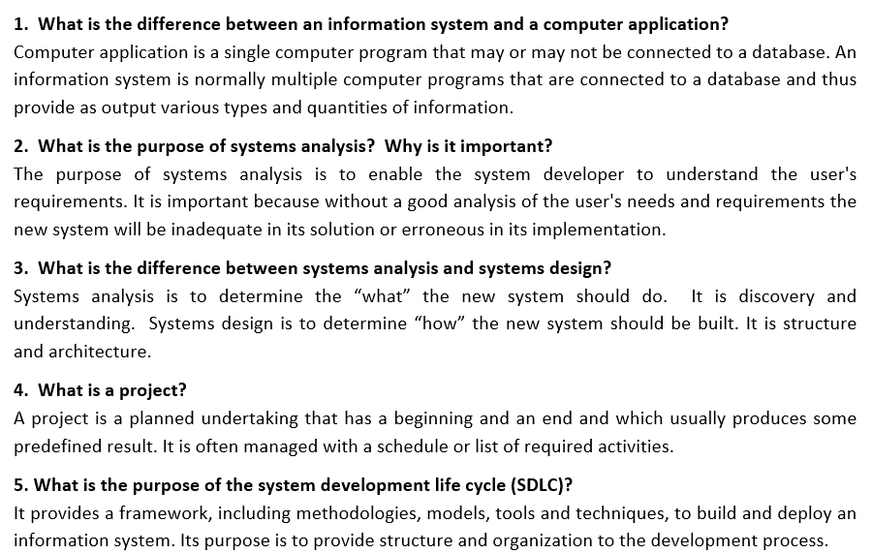
Review Questions

Slide 25
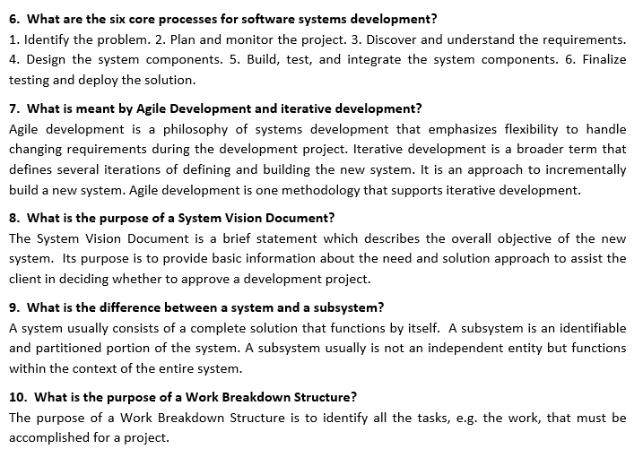
Review Questions

Slide 26
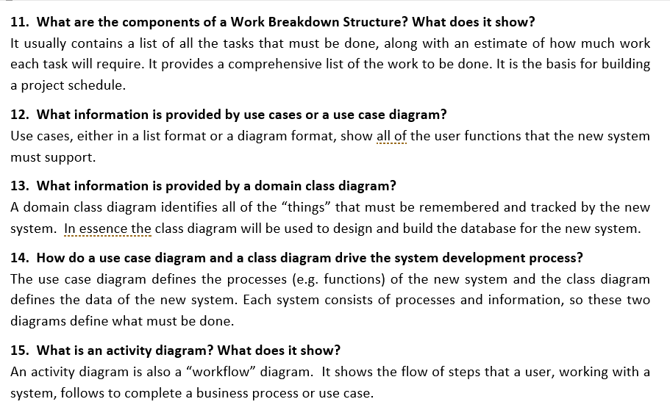
Review Questions

Slide 27
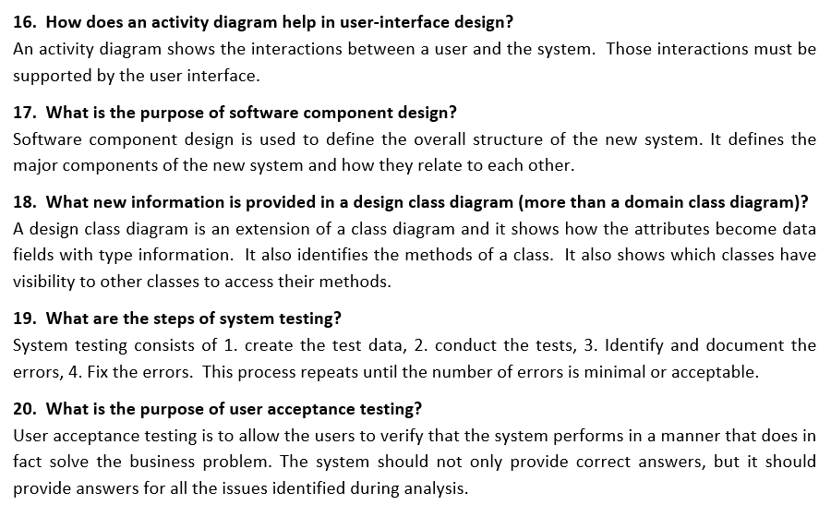
Review Questions

